Slide 2
MLSA-CV
Subtitle or speaker name

Slide 3
Filters in Computer Vision
Enhancing Image Processing

Slide 4
Introduction:-
Definition of Filters in Computer Vision: Filters in computer vision refer to algorithms or mathematical operations applied to an image to enhance its quality or extract useful information. They are used to modify or enhance the visual representation of an image.
Importance of Filters in Image Processing: Filters play a crucial role in various image processing tasks such as noise reduction, edge detection, image enhancement, and feature extraction. They help in improving the quality and interpretability of images.

Slide 5
Filters :-
Filters, in the context of computer vision, are algorithms or mathematical operations applied to an image to enhance its quality or extract useful information. They are used to modify or enhance the visual representation of an image. Filters can be categorized into two main types: linear and non-linear filters.

Slide 6
Linear Filters:-
Mean Filter (or Average Filter)
Gaussian Filter
Sobel Filter

Slide 7
Mean Filter (or Average Filter):-
Mean Filter: This filter replaces each pixel in the image with the average of its neighboring pixels. It is commonly used for image smoothing and noise reduction.
Example:-
In a 3x3 kernel, the mean filter calculates the average of the 9 pixels in the neighborhood and replaces the central pixel with this average value.

Slide 8
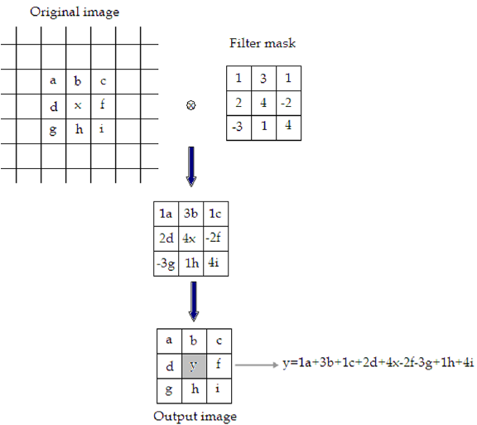
Mean Filter (or Average Filter):-

Slide 9
Gaussian Filter:-
A Gaussian Filter is a type of linear filter used in image processing to reduce noise and blur images. It works by applying a Gaussian function to compute the weighted average of neighboring pixels. This process helps to smooth out the image and reduce high-frequency noise.
Define a Kernel Size
Center the Kernel on Each Pixel
Compute the Gaussian Weights
Compute the Weighted Average
Repeat for All Pixels

Slide 10
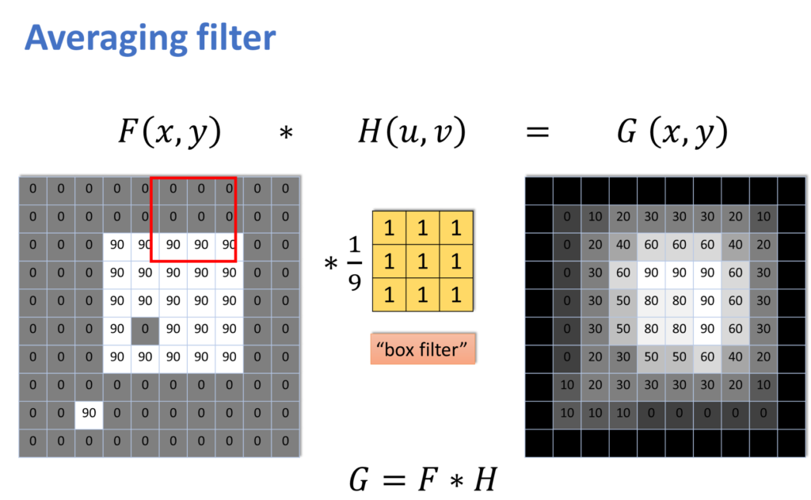

Slide 11
Sobel Filter:-
A Sobel Filter is a type of linear filter used in image processing for edge detection. It works by computing the gradient magnitude of an image, which highlights areas of rapid intensity change, such as edges. The Sobel Filter is based on convolution with two 3x3 kernels, one for computing the gradient in the x-direction and one for computing the gradient in the y-direction.

Slide 12
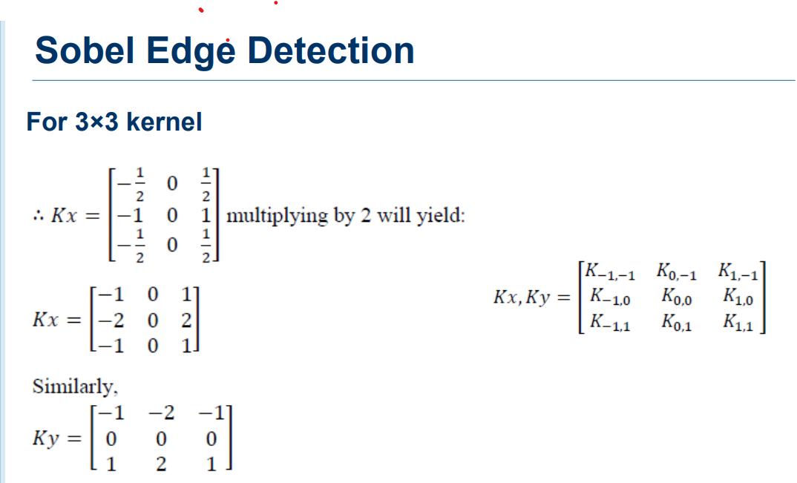

Slide 13
Applications of linear filters in CV:-
Facial Recognition Systems:** In facial recognition systems, linear filters are used for preprocessing images to improve the accuracy of facial recognition algorithms. For example, the Mean Filter can be used to reduce noise in facial images, while the Sobel Filter can be used for edge detection to extract facial features.
Traffic Sign Recognition:** In traffic sign recognition systems, linear filters are used to preprocess images captured by cameras mounted on vehicles. For example, the Gaussian Filter can be used to reduce noise in the images, while the Sobel Filter can be used for edge detection to identify the boundaries of traffic signs.
Medical Image Analysis:** In medical image analysis, linear filters are used for preprocessing medical images to improve the accuracy of diagnostic algorithms. For example, the Mean Filter can be used to reduce noise in medical images, while the Gaussian Filter can be used for image smoothing to enhance the visibility of structures.
Object Tracking Systems:** In object tracking systems, linear filters are used to preprocess images captured by surveillance cameras to improve the accuracy of object tracking algorithms. For example, the Mean Filter can be used to reduce noise in the images, while the Sobel Filter can be used for edge detection to identify moving objects.
Autonomous Vehicles:** In autonomous vehicles, linear filters are used for preprocessing images captured by cameras mounted on vehicles to improve the accuracy of object detection and navigation algorithms. For example, the Gaussian Filter can be used to reduce noise in the images, while the Sobel Filter can be used for edge detection to identify obstacles and road markings.

Slide 14
Follow the practical part.

Slide 15
Thank you
Presenter: Eng.Youssef_Khalaf

